Slide 1
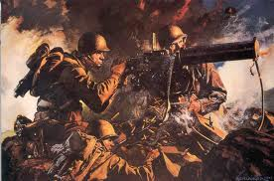
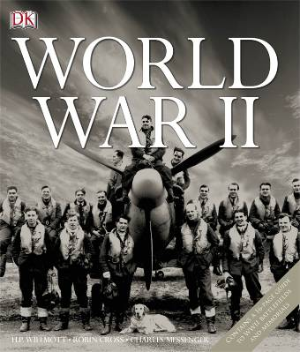
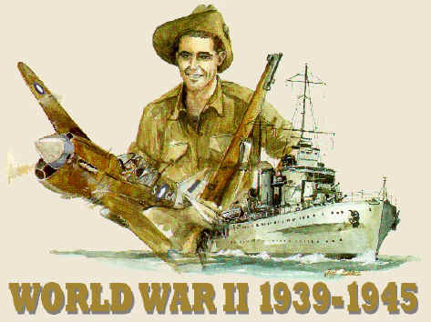
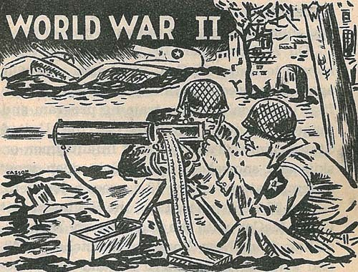
World war 2
By Will Thompson

Slide 2
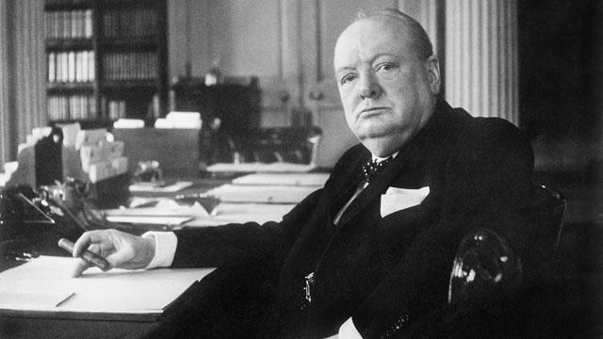
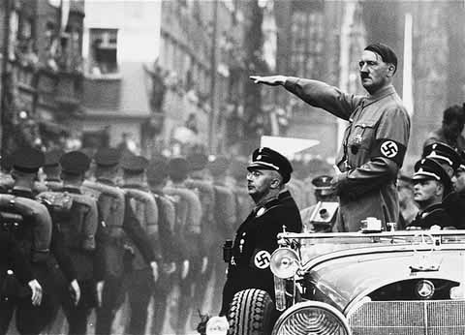
World War 2 started on the 3rd of September 1939 when the Britain and France declared war on Germany. This was due to Hitler invading countries such as France and killing huge numbers of innocent Jews.
Around 50-70 million people died during the second world war (many of those were civilians).
The war finally ended finished on the 8th of May 1945 when Germany surrendered.
The fighting between the second and first world war was completely different.

Slide 3
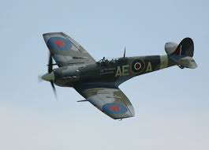
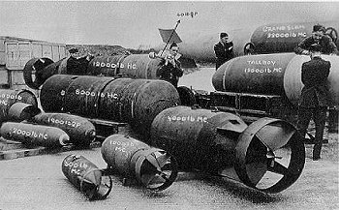
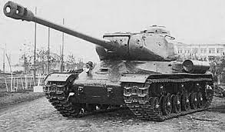
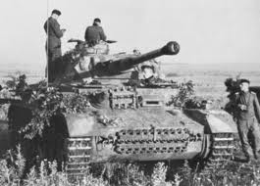
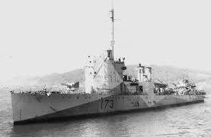
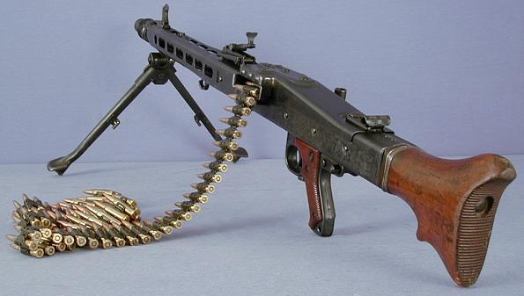
During the second world war in nearly every continent there was fighting. The war was fought completely differently from the first world war. This was because of new technology such as planes, big navy ship, tanks/vehicles and better weapons such as guns that didn’t brake as much and could fire quicker and longer distances and bigger and more powerful bombs.

Slide 4
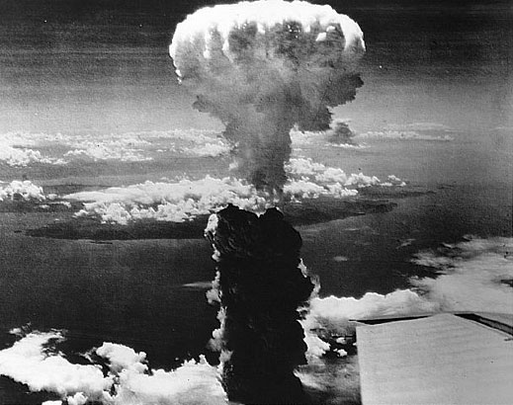
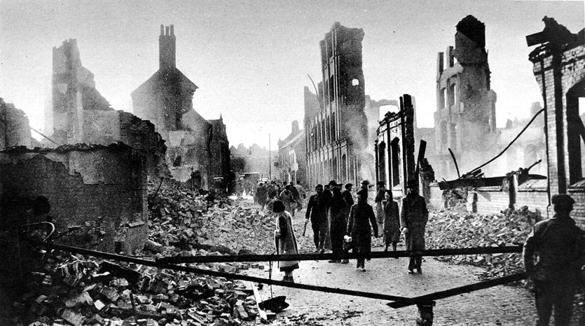
The fighting in the second world war was much different compared to the fighting in the first world war because pretty much all of the fighting in WW1 was done in trenches. Both armies were very close to each other all the time and the soldiers were in the same place nearly all of the time. Whereas in WW2 the fighting was spread out over nearly all of the world. Another major difference was that many civilians were killed by both the Allies and the Axis in WW2. A lot were killed in the blitz and the atom bombs dropped on Japan and also millions of Jews were killed in the holocaust and nearly all of those people were civilians.

Slide 5
After WW2 the 2 biggest and most powerful armies came out undefeated and competed to be the best which later went on to be the cold war.
During the Cold War there wasn’t much fighting like there was in WW1 and WW2 but there was a lot of threats to use nuclear weapons and drop nuclear bombs on each other.
The Cold War was aggravated by the two countries beliefs and the way the government ran the countries. In America the mass majority of people were catholic and in Russia they were atheist. Also Russia is a communist country so everyone gets treated equally and gets the same. Whereas America was a capitalist country which means if you have a better job than everyone else you will get more money than everyone else and people do not have the same luxuries. Another thing that brought tension between them was the race to get to the moon. Who ever could send someone to the moon would be classed as a greater and more advanced nation and both countries wanted to be classed the greatest nation.

Slide 6
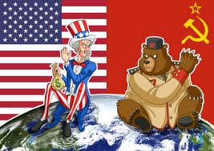
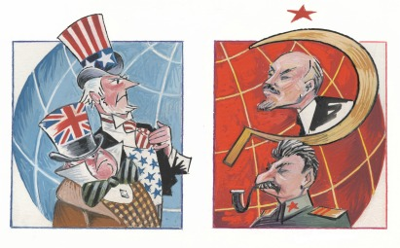
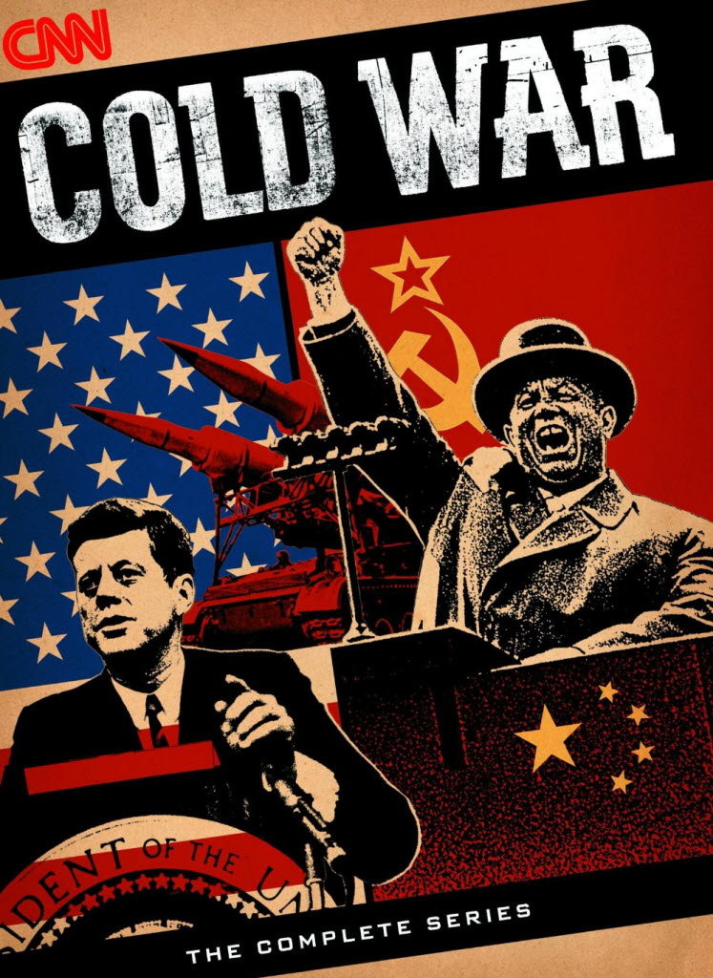
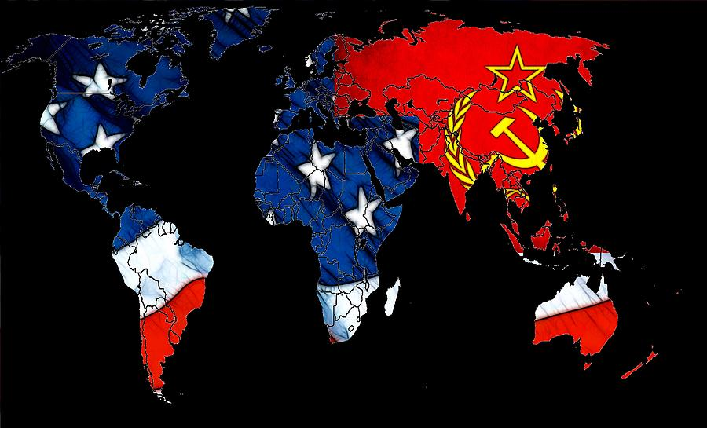
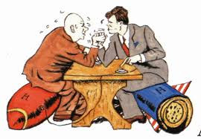
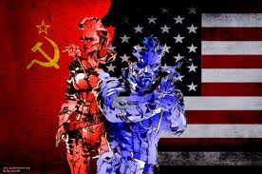
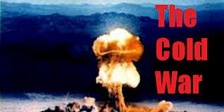
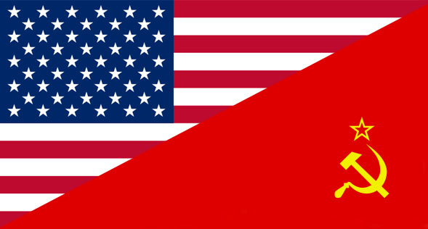

Slide 7
There are a lot of video games such as Call Of Duty, Battlefield and Medal Of Honour that all represent war. They are all based on things that have happened in real life but there are a few things added in to make the game more enjoyable. A lot of people play them for fun but war shouldn’t be fun.
On the game you don’t see the real damage of what war does. Such as you can see dead people on the floor but after a certain amount of time their body disappears but in real life they will be there with missing limbs and their guts hanging out.
Another big difference is that men cry in war because of pain or fear, but it isn’t shown in games and you can’t see men dying around crying out for help.
But the main difference is you get unlimited lives on a game but in real life you only get one chance.

Slide 8
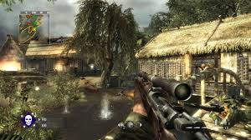
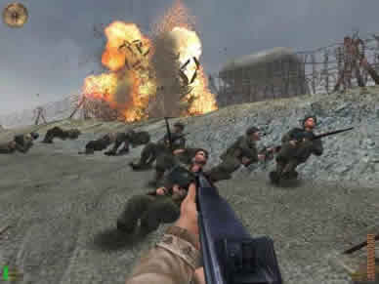
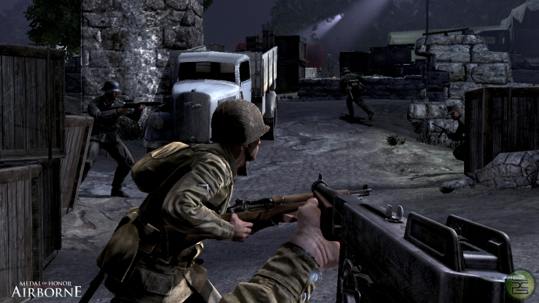
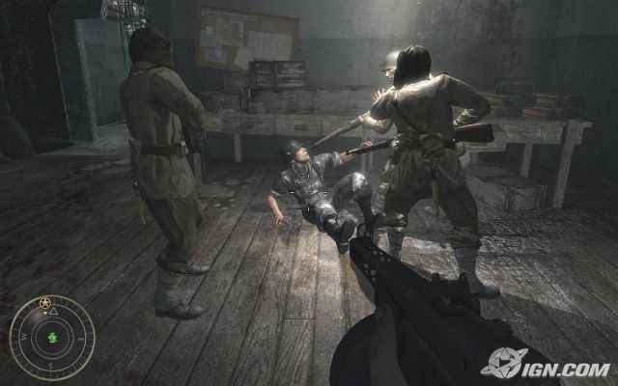
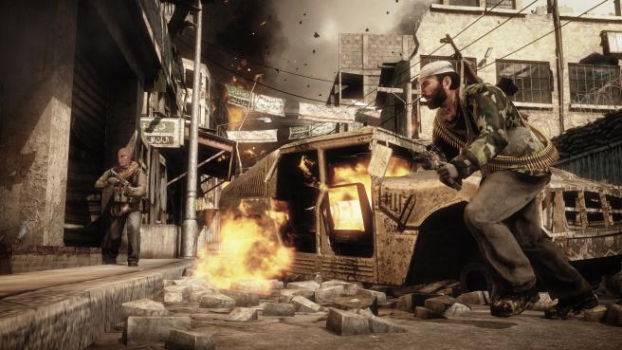
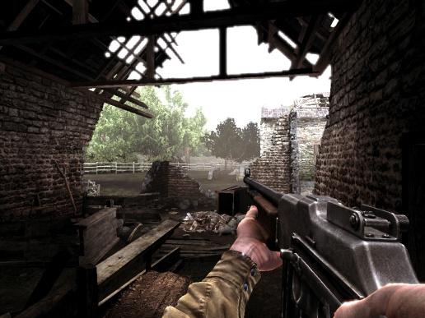
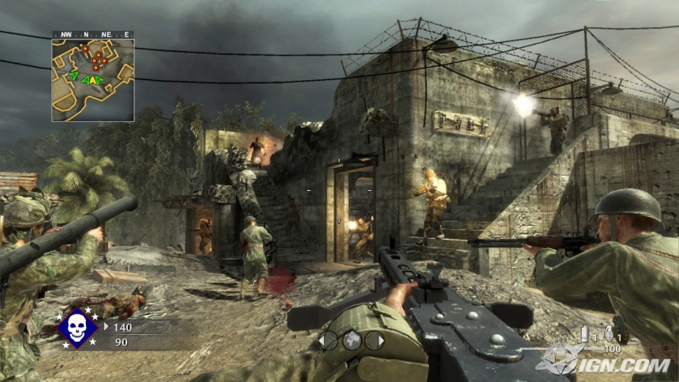
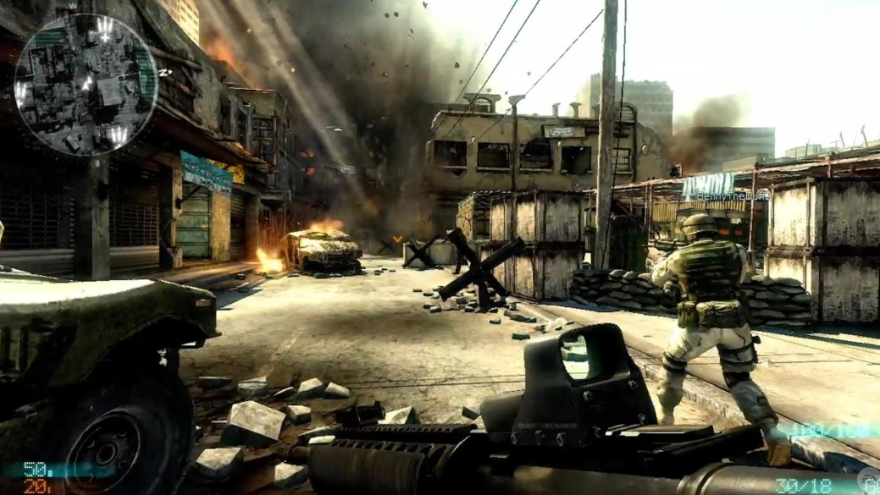

Slide 9
There are loads of war films that have been made some better than others and some more realistic than others.
There are some films that really show what war can be like and are very realistic, such as Saving Private Ryan and The Enemy at the gates. These two films are realistic because they show the viewers what it is like to be in war. A good example of this is at the beginning of Saving Private Ryan at D-Day. All over the beach there are dead bodies and men with no arms or legs, there are bombs going of every where and the sea is red with blood. Also you can see how the men cried out for their mums as they died and how people broke down and couldn’t take it all. In the film enemy at the gates it shows a realistic scene of how some Russian soldiers charged at the Germans and then retreated and got classed as traitors and were shot by their fellow soldiers and friends.

Slide 10
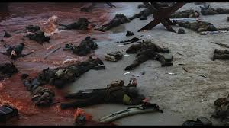
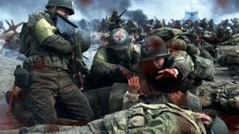
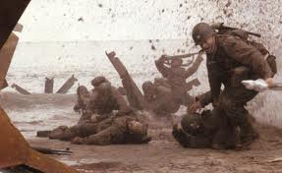
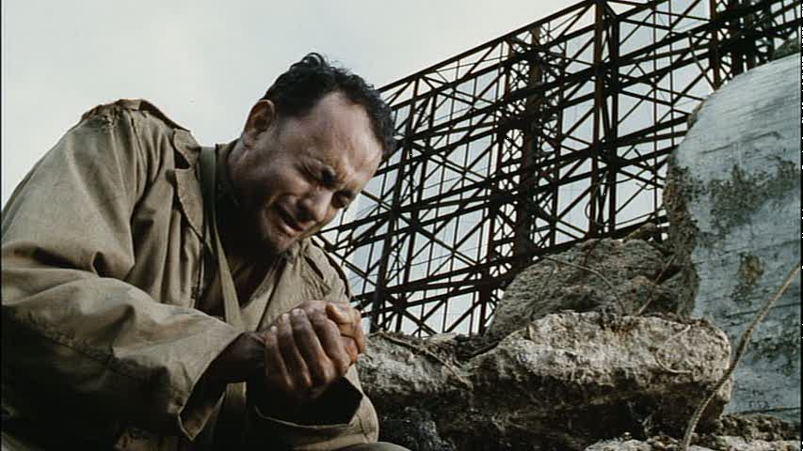
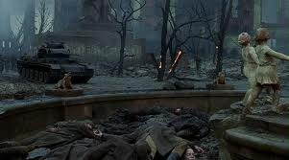
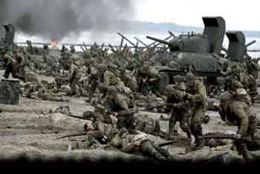
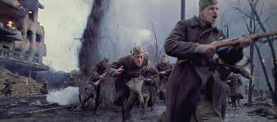
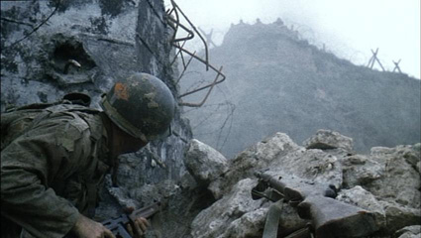
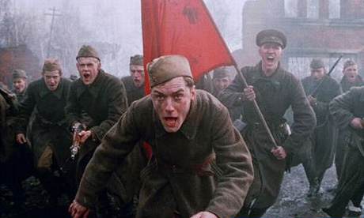

Slide 11
Overall WW2 has changed the way wars are fought because nearly all of the guns, tanks, bombs and ships are similar to the ones used in the war. I think video games that are based on real life wars the missions on those games are what they were actually like but the games are not realistic. A lot of war films that are based on real wars are good films but just not realistic such as Rambo, but there are other films such as Saving Private Ryan that are realistic and are still good films.

Slide 12
THANKS FOR WATCHING

